Slide 1

Module 4:
Refuting
Materialism

Slide 2













Review – 4 Worldviews
Materialism
Dualist
Polytheism
Monotheism
Notes:
Why won't these work?
1.)Atomism: time + chance, acting on matter.
Atoms can't be universal, constantly change.
Logic is universal and unchanging.
Atoms insufficient as source of moralsm, choice, and logic.
We all hold others to moral standards. No one lives as if atheism is true.
2.)Confucious say? That's his opinion.
The Christian God knows everything. He doesn't
3.)Multiple gods means competing sources of authority, destroying the possibility of unchanging universals such as logic or truth in morality.
Also, how was it revealed?
Able to create life and the universe?
4.)The other Abrahamic religions depend on Christianity and contradict on their own standards.
-Others: can their deity support universals? Creation? Human nature, value

Slide 3
Materialism
Believes
  Everything that exists is physical
  Love, hate, and truth are all chemicals
  and are all human-made constructs
  that somehow helped us evolve to where we are now

Slide 4

Why can't humans/societies/popular opinion be define truth?
humans constantly
disagree
And scientific
theories are
constantly
disproven
(gravity)
(cosmology)

Slide 5

Can a description of...
Atoms colliding with one another
How rockslides work
Or
having memorized all biology
and physics text books...
And knowing all about evolutionary
theories...

Slide 6

Does that give you a prescription
For whether these are right or wrong?
  love or eat our neighbors?
  feed or kill the weak?
  (Hitler vs. Mother Theresa)
  Enslave inferior humans or declare equality?
  Eat our dead or bury our dead?
  It is always ok to lie
  It is always ok to murder
Evolution describing what happened
does not tell you how it 'ought' to happen.
You can't get an ought from an is
Notes:
This is why we say you cannot get
And ought
From an is.

Slide 7
We are not saying
Materialists cannot hold true beliefs
Or that they can't act morally upright
They just don't have a good reason to believe materialism causes it
They also can never truly know if they are ever right about anything, according to materialism

Slide 8
"We should just be concerned about human flourishing"
Why should humans flourish?
  Why not dolphin flourishing?
He will only have opinions
What did he say about human opinions?
  You can never know what's true
Notes:
You will hear an ethic in response,
Which is pragmatism.
Whatever ethic you start with is what you end with.
It's arbitrary/opinion

Slide 9
Free will
Did the materialist have free will to choose
That he
ought to be concerned
about human flourishing?
Do unguided atoms
in his skull
acting on time and chance produce that choice?
Should we prosecute our criminals
if they are only dancing to the music
of their DNA?

Slide 10

We are not saying
Materialists have no free will
They just don't have a good reason to believe materialism causes it

Slide 11

If evolution produced our ability to think
Evolution is only concerned about survival
Not truth
Then the materialist has no good reason
to believe materialism causes it

Slide 12

Next...
We show why logic could not exist
If materialism were true

Slide 13

We use logic with every thought
Non Contradiction
It can't be both true and false
at the same time
Example:
The bill cannot
be paid
and
not paid
at the same time
You use this when you
detect lies

Slide 14


Logic - Identity
Identity
A fish is a fish,
is not a car.
(it is what it is, it's not what it's not.)
I am me.
I am not you

Slide 15




Unlike matter...
Logic is (NeP)
  Everywhere
  Does not change
  Pre-exists the universe
Matter is
  In one place at a time
  Constantly changes
  Exists after the universe
  They are exact
  opposites!

Slide 16
We are not saying
Materialists can't use logic
They all do
They just don't have a good reason to believe materialism causes it

Slide 17


Example of how logic preexists humans
Notes:
Before there were humans
on the earth
Was it true,
even though a human mind
did not exist
to think it?
What about the universe?

Slide 18
There are lots of other immaterial realities
Logic
love
Kindness
Classes
Numbers
truth
Justice
human dignity
We're only covering
a few:
Truth
Truth in morality
Logic

Slide 19
Here is one cool example
of how humans
can not
be the source of knowledge
This mathematical formula:
(z_k+1 = z_k2 + c)
It existed before humans
discovered it.
And it's not made of material
Numbers are not material
And you can't destroy them

Slide 20

Mandelbroth sets pre-exist humans.
We only discovered math.

Slide 21
Discovered. Not invented
(double-click icon to play)

Slide 22
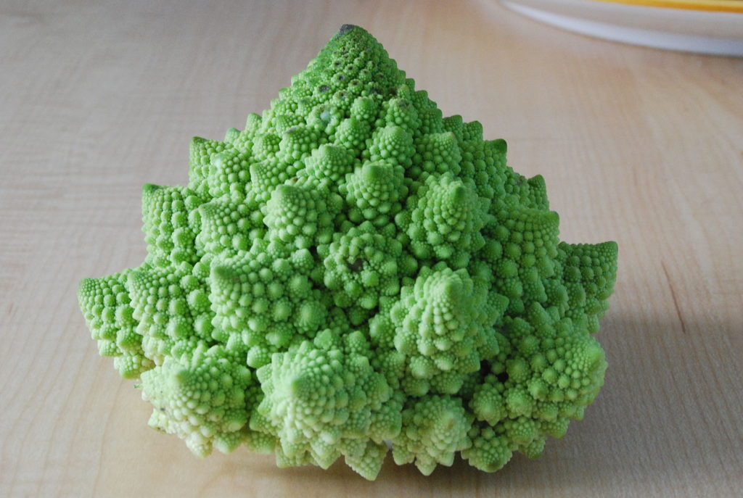
Fractal patterns exist in the physical world
Found in water, trees, human biology, clouds, etc.
That doesn't
happen
in a
random,
chance
universe
Existed
before
evolution
could happen

Slide 23
If all reality is
time and chance
acting on matter
The materialist should expect
  Randomness
  No order
  No predictability/repeatability
Instead, we get the opposite...

Slide 24

Induction. science assumes it
The future will be like the past
The laws of nature/physics
will act the same way
tomorrow as today
That does not follow from materialism
It does
follow from the Christian God
making an orderly creation (Gen 8:22)
from a God who created
with a purpose

Slide 25

An example
Every morning, Henrietta gets fed
It expects the future to be like the past
But one day, instead of being fed,
it loses its head
Did Henrietta have a good reason for believing the future would be like the past?
based on observation alone?

Slide 26
Has any of us
Observed the future? no.
Observed the connection between the past and the future? no.
We have the habit of expecting things, but we do not know that from observation alone

Slide 27



Science
Relies on limited human observation which refutes itself,
using what is to be proven
as the evidence.
the
Human sense perception can only be verified with more human sense perception.
Without revelation from one with all-knowledge, we are not justified to trust those senses.
Notes:
Can someone give some examples of human sense perception?
-smell
-hearing
-taste
-touch
-seeing

Slide 28
We are not saying
Materialists do not believe in gravity
They do
They just don't have a good reason to believe materialism causes it

Slide 29

Objection: Circular reasoning!
"You keep saying God is your authority for everything. Isn't that circular reasoning?
That's a logical fallacy!"
The Christian God is necessary for logic to exist,
with no authority above himself.
So of course the Christian claims always end with his ultimate authority - God
Every ultimate authority is ultimately circular. For the unbeliever, it is himself.

Slide 30
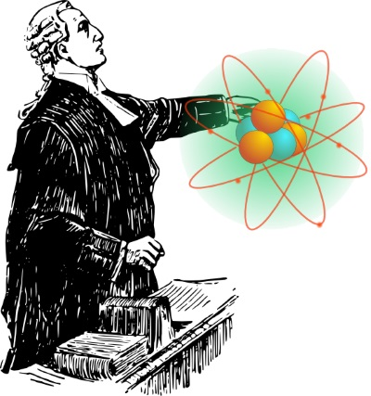
Because God is the source of logic,
To deny God's existence is to deny logic itself.

Slide 31

That doesn't prove God exists?
The Christian God being necessary for logic is an indirect argument.
It demonstrates the absurdity of denying the existence of the Christian God.
It is logical to believe in His existence.
In the scientific community,
it's called abduction
Notes:
Abduction:
Reasoning to the best explanation.
Use process of elimination.

Slide 32

Remember.
There is a difference between
Somone being persuaded
And what is true
Imagine telling the doctor
you don't have diabetes
You being convinced
has nothing to do
with the truth
of what is

Slide 33
Why
Should you bring a materialistic atheist to the realization that he can't have
  Truth in morals
  knowledge
  free will
  If their worldview were true?
It gives a logical reason to consider the truth
of Christianity

Slide 34

Can you give examples where materialism fails?
Coherence
(not self-contradictory)
Explanatory power
(explains this world and the nature of humans)
Justification Force
(Good reason to believe it)
Notes:
Coherence:
-I believe materialism is true
even though materialism makes truth impossible
-I believe human social standards and behavior are evolved
even though he believes murder and child predators are wrong (a moral truth claim)
Explanatory Power:
-Big Bang
-Darwinian Evolution
-Abiogenesis
Justification Force:
-Humans are the result of time and chance, acting on matter
Yet use eternal, universal, unchanging logic.

Slide 35
Comprehension Questions
What is the only logical use of circular reasoning?
Give one example of using logic.
Why can't evolution be used to tell us how we ought to behave?
Give one reason for humans not being the source of truth
Notes:
A presupposition is an assumption that is so basic, you can't back it up with anything else
What do we mean by irrational?
-To be irrational is to not follow reason.
To be reasonable is to have a good reason, a justification for what we believe.
It is not rational to believe anything you want to.
Why is it irrational to believe the laws of logic "just are" a property of the universe?
-Material matter could not make a choice to start the universe
-Logic is universal and consistent. Matter can only be in one place at a time and is in constant flux.
Is also prescriptive
-It is unreasonable to not have a reason for a belief

Slide 36

Materialism is unable to
make human experience
or truth, logic, and morality possible
Demonstrated the absurdity of
belief in materialism

Slide 37

Next Module:
How to refute non-Christian
Dualistic worldviews

Slide 38

End of Module
4
Questions?

